Slide 1

Opening a new Halal Restaurant in London, England
By: Bilal Siddiqui

Slide 2
What is the Problem?
There is a limited amount of halal options in most countries outside the Middle East.
Location of the halal restaurant or any business is a huge factor in the future of its success or failure.
Question?
Where is a good place to open a halal restaurant in the city of London?
Goal
To analyze and select the best options to open a new halal restaurant in London, England, one of the biggest and most popular cities in the world.

Slide 3

Data
What?
Venue data on restaurants, specifically Indian restaurants
Gather the neighborhoods in London
Latitude and longitude coordinates of the neighborhoods
How?
Foursquare API
Airbnb website for neighborhoods
https://www.airbnb.com/locations/london/neighborhoods
Geocoder package

Slide 4
Methodology
1) Web scrape neighborhoods from Airbnb page 2) Use geocoder for latitude and longitude of neighborhoods 3) Foursquare API for venue data 4) Group data gathered from sources 5) Filter venues specifically to “Indian Restaurant” 6) K-means clustering on data 7) Visualize 8) Obtain results 9) Actionable information

Slide 5
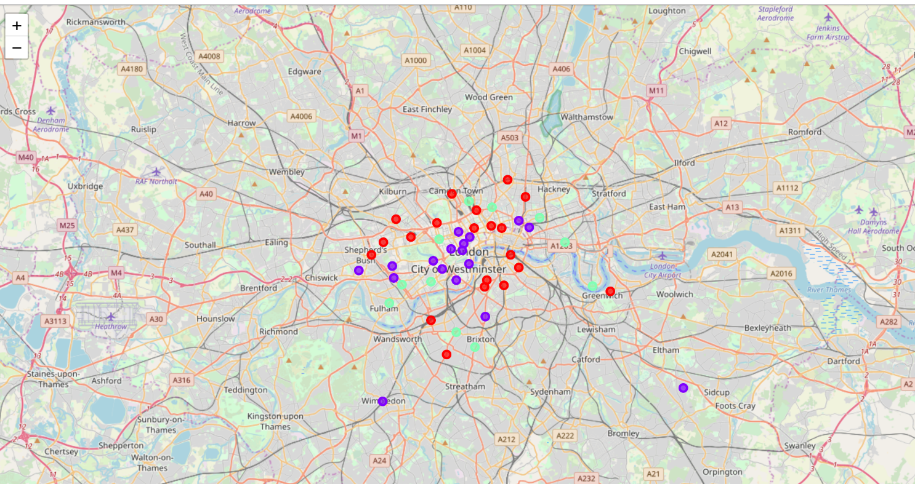
Results
Cluster “Zero” : Few Indian restaurants
Color Green
Cluster “One” : Greatest number of Indian restaurants
Color Purple
Cluster “Two” : Moderate number of Indian restaurants
Color Red

Slide 6
Discussion/Suggestions
Most Indian restaurants are focused in the inner city part of London
Cluster 1 faces an intensive amount of competition
There are outside factors to consider
Cluster Zero has very low competition, but in the outer part of city. May have drawbacks.
Cluster One faces an intensive amount of competition. Newer restaurants and business individuals would want to avoid.
Cluster Two is the best option as it is in the inner part of the city, but somewhat outside with a moderate amount of competition.

Slide 7
Conclusion
Where is a good place to open a halal restaurant in the city of London?
The neighborhoods in cluster 2 are the preferred locations
Cluster zero is a solid option as well with very little competition
Let’s get out there and open someone’s favorite new restaurant!

